Slide 1
High-Radix Arithmetic-Logic Unit (ALU) based on composite memristor systems
Shivam Rishi (157EC15)
Shreya Seth (160EC15)
Sourav Bhattacharjee (171EC15)
Tushar Kumar (187EC15)
Guide: Dr. Kunwar Singh

Slide 2
Timeline of the Project
Literature Survey
Threshold Type Memristor Model
Memristor Radix-4 MultiStateSwitch
(MSS)
Modified Crossbar Structure
High Radix to Binary Converter
Basic Crossbar Memory
Proposed ALU Structure

Slide 3
MOTIVATION

Slide 4
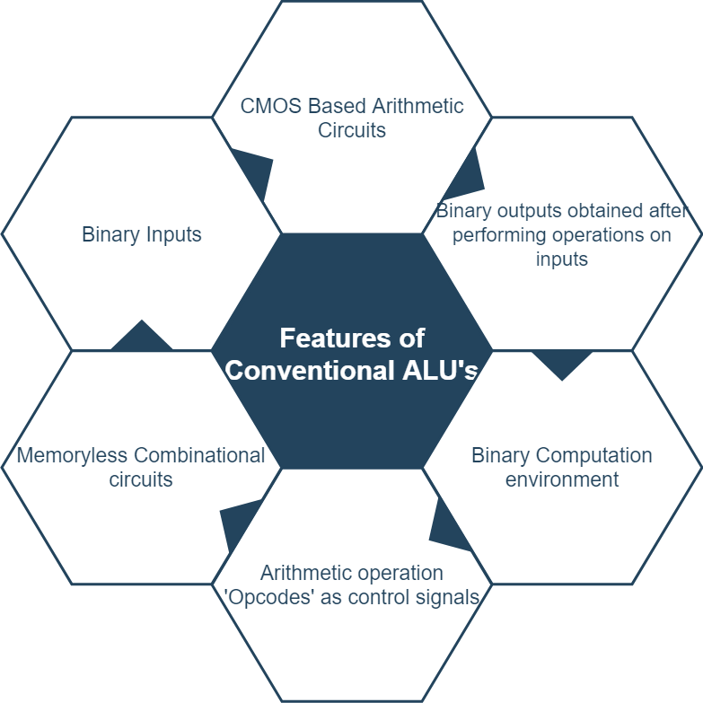
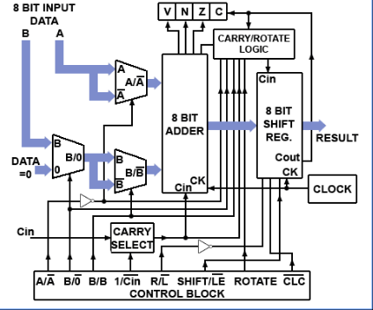
Conventional ALUs

Slide 5
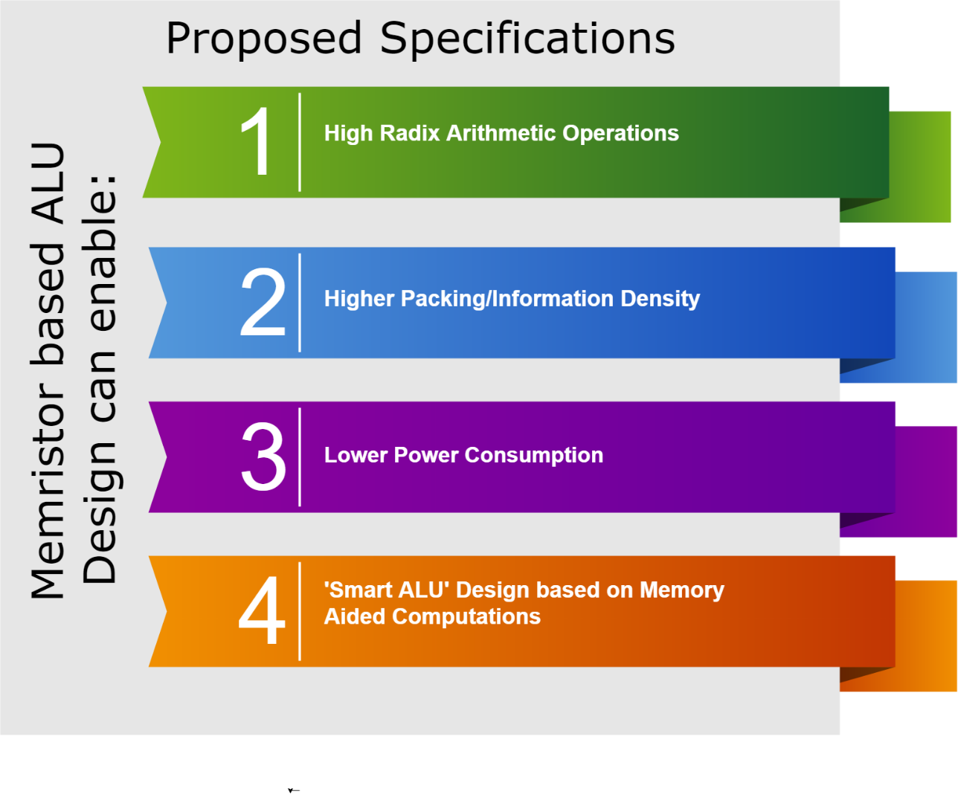
Possible Improvements on top of Conventional ALU design
Proposed ALU Architecture consisting of:
Memristor based High Radix Switches used in development of storage cells.
Memory-Aided Computing for fast and efficient operations.
Dedicated operation blocks leading to scalable architecture with lesser footprint due to utilization of Memristors.
Local Memristor ‘Cache’ in dedicated blocks.
Made Possible by

Slide 6
Proposed ALU Architecture

Slide 7
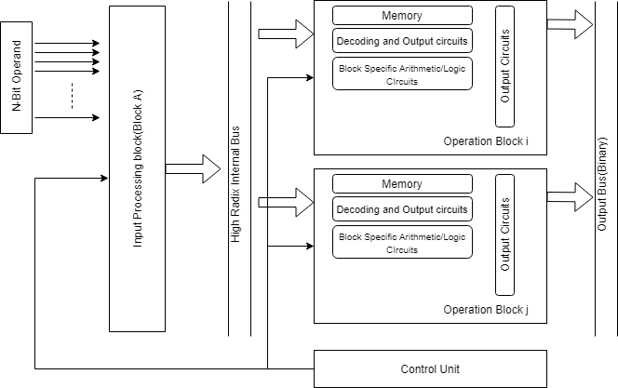
Block Diagram- General Structure of ALU
Features of Proposed Architecture:
High-Radix internal representation and Computation
Scalable to Greater number of operations just by inserting new blocks
Memory-Aided Computing
Exploiting benefits of Memristor such as less area and lower power consumption

Slide 8
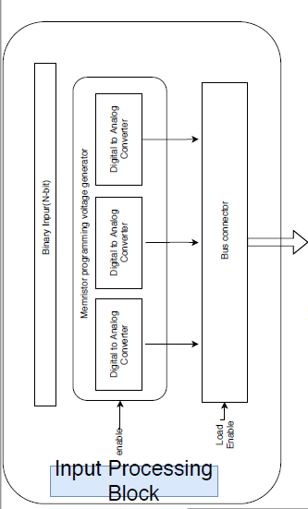
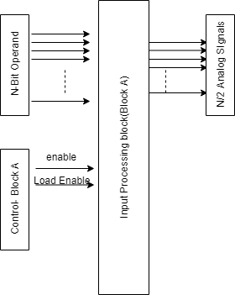
Input Processing Block
Input Processing Block
Detailed Block
Implementation
… N/2 DACs
Functions:
Converts Binary operand into radix-4 signal.
Binary Operand | Analog Signal (V)
00 01 10 11 | 0 2.5 4.5 6.5

Slide 9
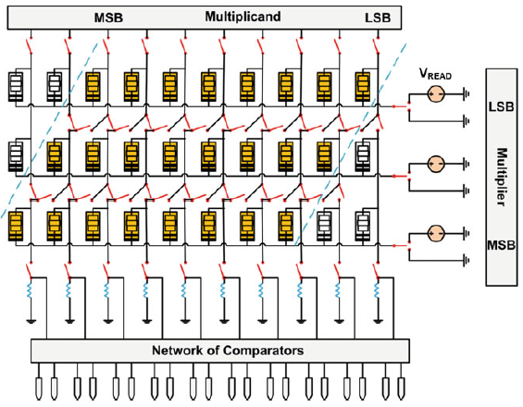
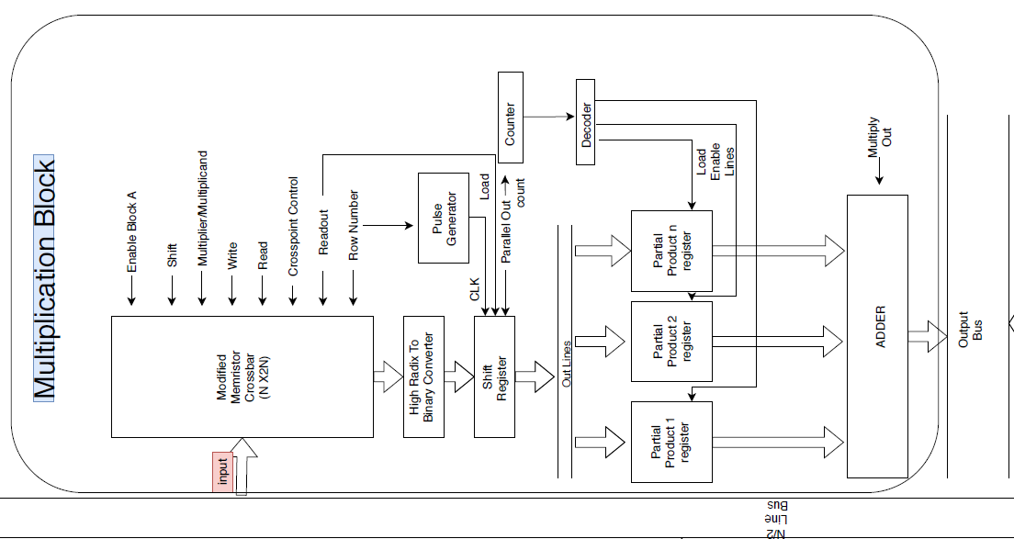
Multiplication Block
Detailed Block
Implementation
Radix-4 Multistate Switch(MSS)
Modified Crossbar
Modified crossbar-based memory provides [1]:
Parallel read/write of data
Fast partial product creation for multiplication
Storage of information in a compact, high-radix form
Binary Arithmetic Circuits performed using CMOS peripheral circuits

Slide 10
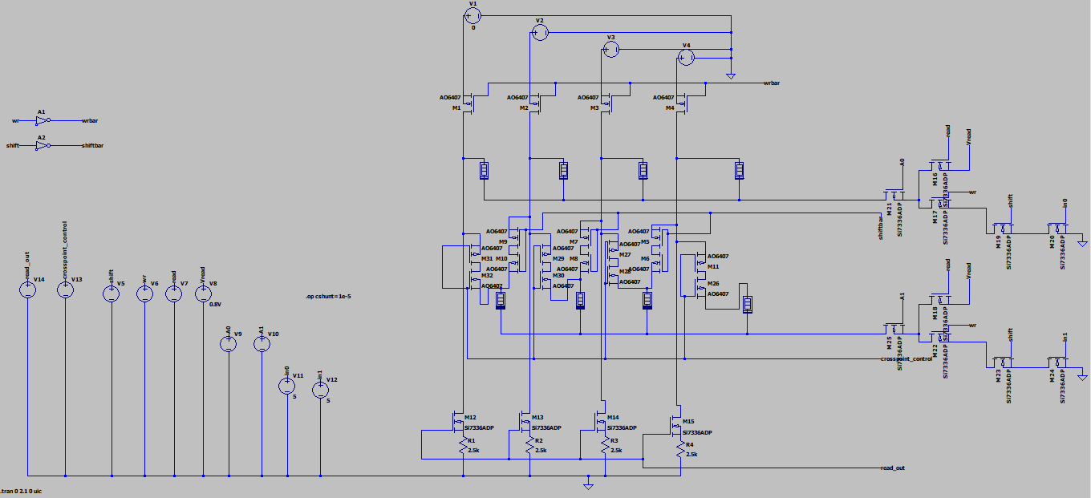
Modified Crossbar Structure (SPICE SIMULATION)
Modified Memristor Crossbar Schematic
a

Slide 11
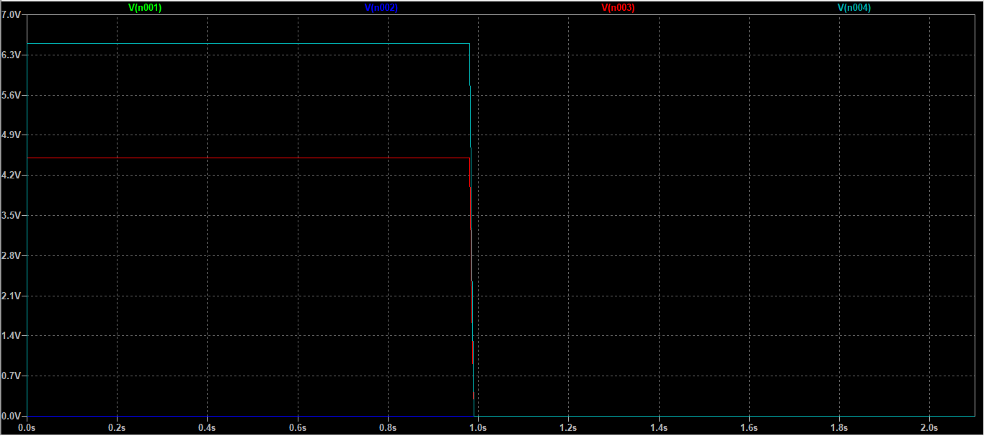
Modified Crossbar Structure(SPICE SIMULATION)
INPUT SIGNAL
(0023)₄
Input Signals
a

Slide 12
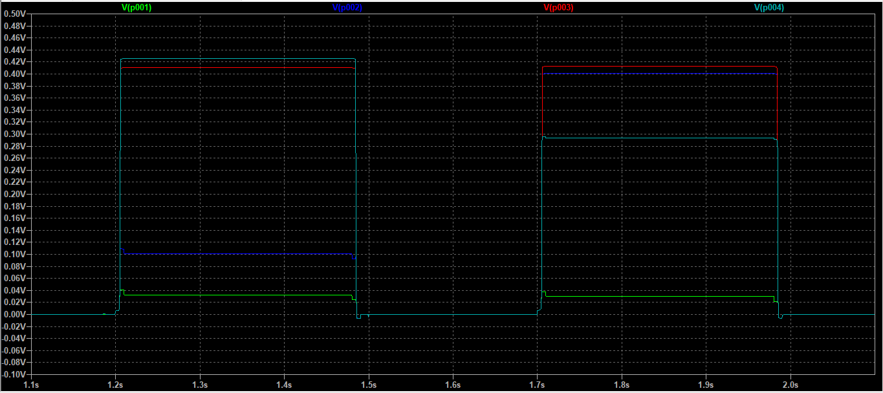
Modified Crossbar Structure(SPICE SIMULATION)
OUTPUT SIGNAL
(0023)₄
OUTPUT SIGNAL
(0230)₄
Shifted Partial Products(Output Levels)
a

Slide 13
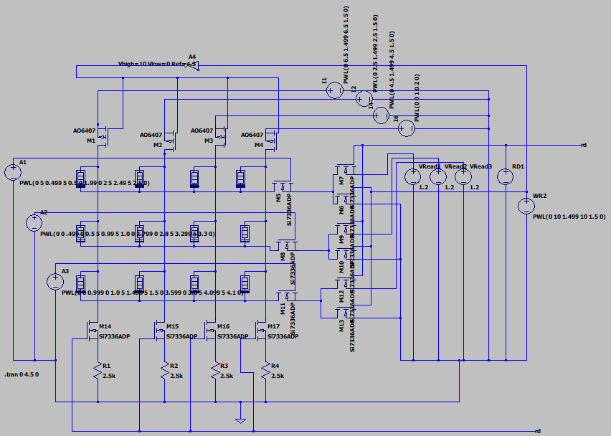
Basic Crossbar Memory(SPICE SIMULATION)
Basic Memristor Crossbar Schematic
a
[2,3]

Slide 14
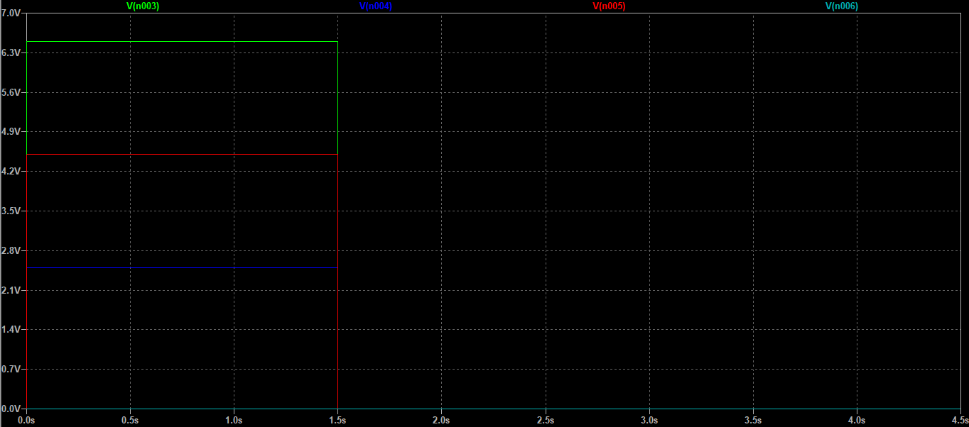
Basic Crossbar Memory(SPICE SIMULATION)
INPUT SIGNAL
(3120)₄
Programming Voltages
a

Slide 15
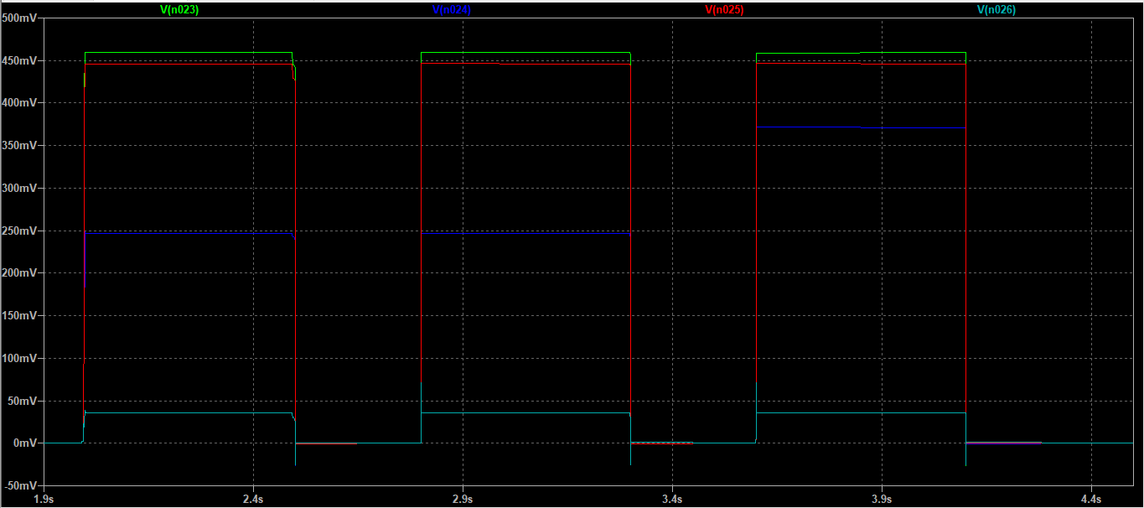
Basic Crossbar Memory(SPICE SIMULATION)
OUTPUT SIGNAL
(3120)₄
Output Signals
a

Slide 16
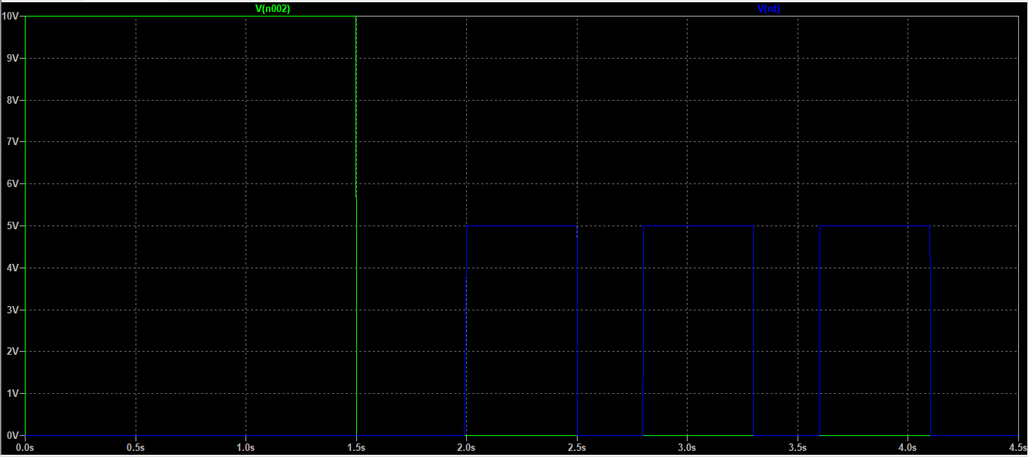
Basic Crossbar Memory(SPICE SIMULATION)
Control Signals
a

Slide 17
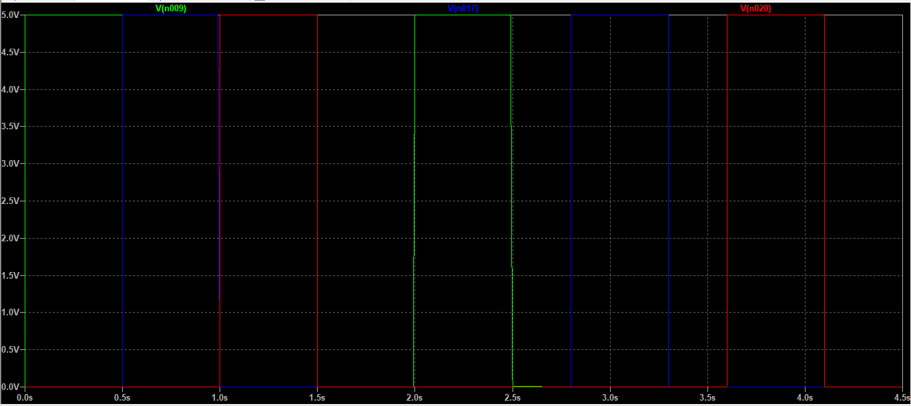
Basic Crossbar Memory(SPICE SIMULATION)
Row Select Signals
a

Slide 18
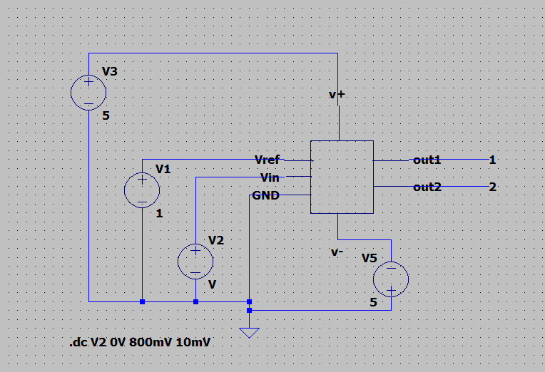
High Radix To Binary Converter(SPICE SIMULATION)
Converter Usage

Slide 19
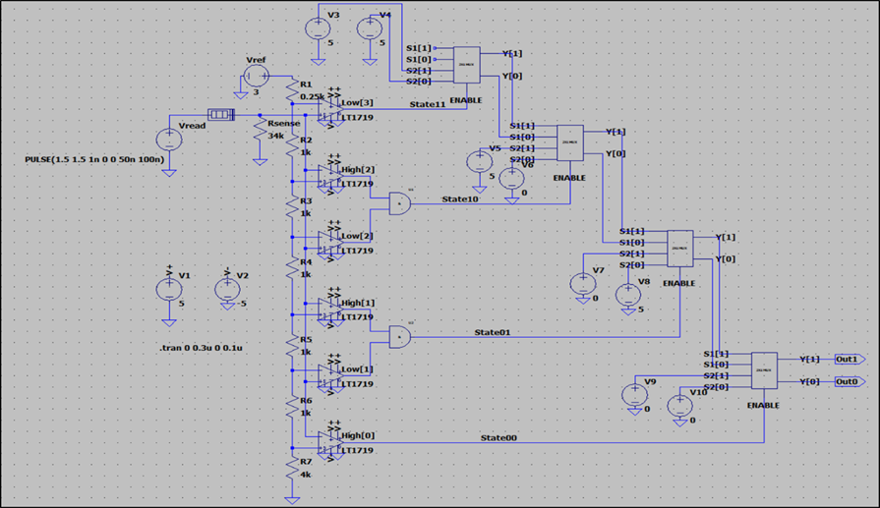
High Radix To Binary Converter(SPICE SIMULATION)
High Radix to Binary Converter

Slide 20
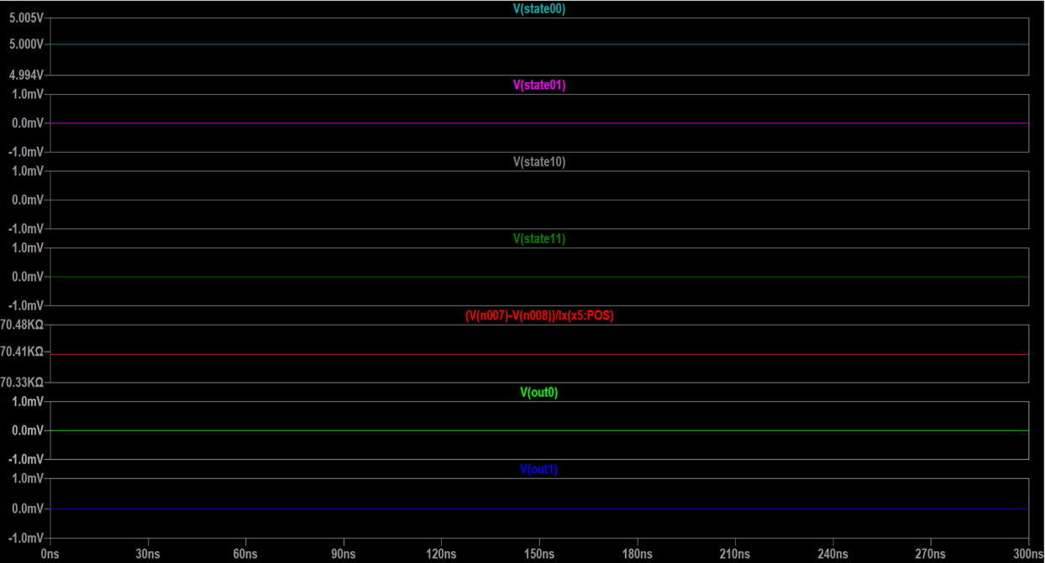
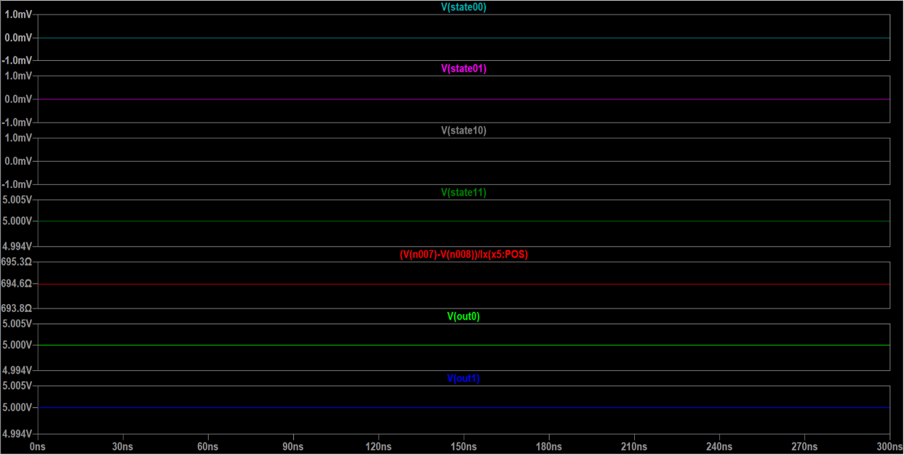
High Radix To Binary Converter (SPICE SIMULATION)
Output level at Input voltages

Slide 21
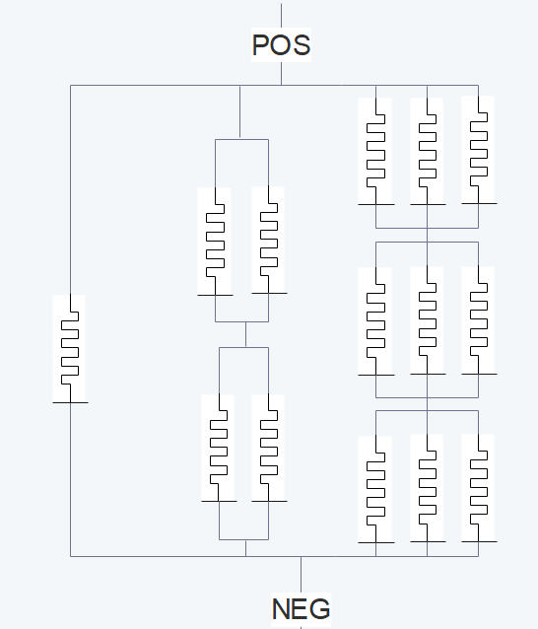
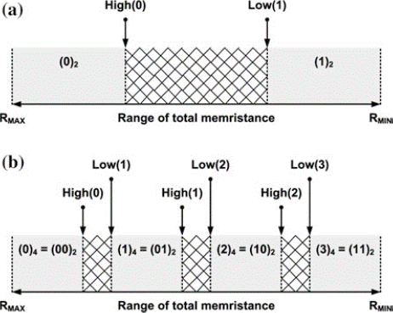
The Memristive Radix-4 Multistate Switch
It is capable of storing data in radix-4 format and can have four states: (0)₄, (1)₄, (2)₄ and (3)₄
The range of composite memristance is [Ron/3, Roff/3]
The threshold voltage for the first branch is VSET, second branch is 2VSET and third branch is 3VSET

Slide 22
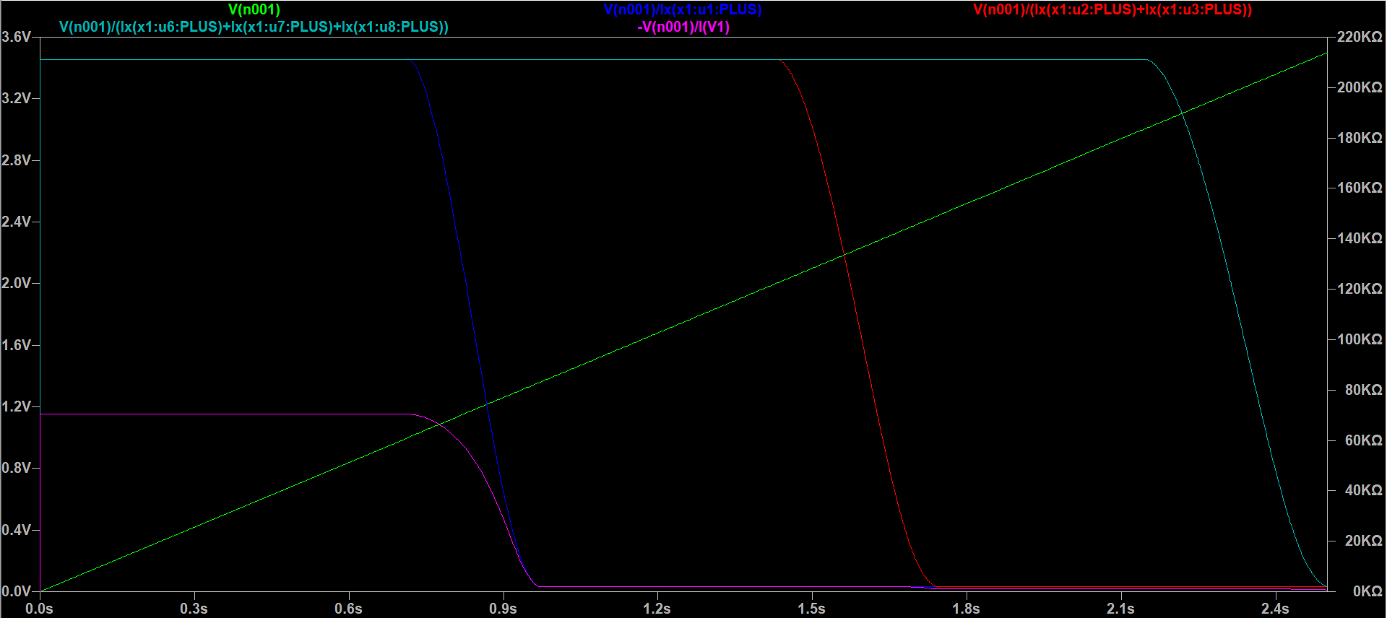
Radix-4 Multistate Switch (SPICE SIMULATION)

Slide 23
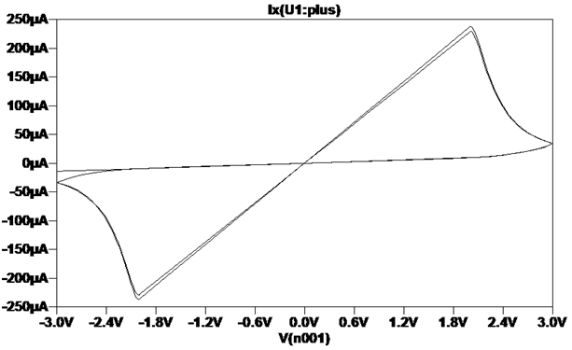
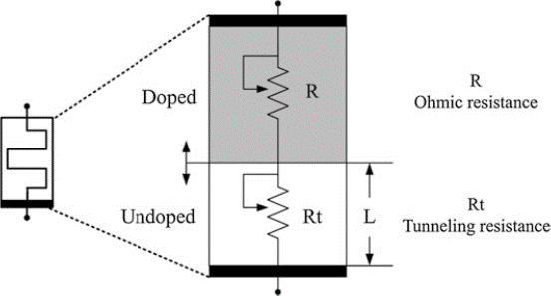
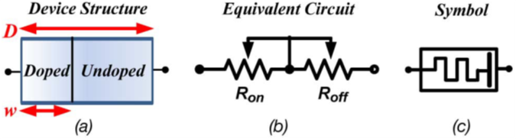
Threshold Type Adaptive Memristor Circuit Model
Equivalent circuit of the coupled ohmic-tunneling variable-resistor circuit model [1,4]
Pinched Hysteresis [5]

Slide 24
References
[1] Vourkas, Ioannis, and Georgios Ch Sirakoulis. Memristor-based nanoelectronic computing circuits and architectures. Vol. 19. Cham: Springer International Publishing, 2016.
[2] Hamdioui, Said, et al. "Memristor based computation-in-memory architecture for data-intensive applications." Proceedings of the 2015 design, automation & test in Europe conference & exhibition. EDA Consortium, 2015.
[3] Zhang, Yang, et al. "A novel design for memristor-based logic switch and crossbar circuits." IEEE Transactions on Circuits and Systems I: Regular Papers 62.5 (2015): 1402-1411.
[4] Kvatinsky, Shahar, et al. "TEAM: Threshold adaptive memristor model." IEEE transactions on circuits and systems I: regular papers 60.1 (2012): 211-221.
[5] Chua, Leon. "Memristor-the missing circuit element." IEEE Transactions on circuit theory 18.5 (1971): 507-519.
[6] Ho, Yenpo, Garng M. Huang, and Peng Li. "Dynamical properties and design analysis for nonvolatile memristor memories." IEEE Transactions on Circuits and Systems I: Regular Papers 58.4 (2010): 724-736.
[7] Kvatinsky, Shahar, et al. "VTEAM: A general model for voltage-controlled memristors." IEEE Transactions on Circuits and Systems II: Express Briefs 62.8 (2015): 786-790.
[8] Radwan, Ahmed G., and Mohammed E. Fouda. On the mathematical modeling of memristor, memcapacitor, and meminductor. Vol. 26. New York: Springer, 2015.

Slide 25
Thank You.

